Slide 1
Leveraging Air Quality Data and Health Informatics to Mitigate Asthma Symptoms Evan Rixom – 4/16/25 – SAT5424

Slide 2
AGENDA
Background/Key Challenges
Current Tools/Tech
Future Work
Conclusion

Slide 3
Background / Key challenges
Background
Environmental Data in Health Informatics
Asthma & COPD affect millions globally
Environmental triggers are often preventable or predictable
Problem
Respiratory conditions (such as Asthma and COPD), often worsen depending on the air quality and current air pollutant levels.
Research has shown that fine particulate matter pollution exacerbates symptoms. One study showed that CO had the strongest positive correlation to hospital visits.
Patients usually react after symptoms begin
Real-time data could allow patients to take action in advance
Key Challenges
Data Integration
Data Granularity
Latency/Delays
Ethics

Slide 4
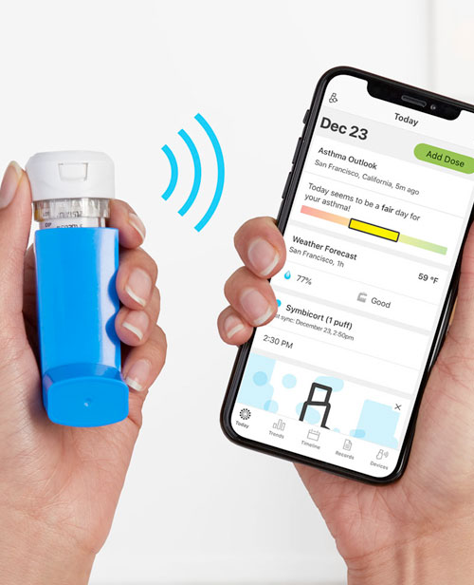
Current tools/tech
Propeller Digital Health Platform for Asthma
“Smart Inhaler”
Inhaler sensors that pair with smartphone tracking both control and rescue inhaler usage
Platform for respiratory disease management
Tracks medication usage, location data, symptom triggers, air quality data, weather data, etc.
Provides medication tips, a daily “asthma forecast” based on air quality, and shareable reports with Dr.

Slide 5
Current tools/tech
Studies show this platform led to improvement in asthma patients
A 12-month study of 39 patients in the Journal of Telehealth and Telemedicine showed a reduction in COPD-related ED visits and hospitalizations.
Other studies showed higher medication adherence and decreased rescue usage
Patient Satisfaction was also found to be high

Slide 6

Current tools/tech
Connected Inhalers:
Propeller Health has shutdown sadly.
Teva Digihaler has shutdown.
Amiko Repiro is still active and tracks both usage and generated flows.
Adherium Hallie Smrtinahlers are similar.
And more!
Smart Air Quality Sensors
PurpleAir sensors
Airthings View Plus

Slide 7
Future Work
Future Advancements
Future Work/Research
Integrate Data from:
EPA/PurpleAir/Smart Air Quality Sensors
Smart Inhaler technology (Ex. Propeller Health)
EHR systems
Personal app-based alerts
Build ML tools to identify triggers, risks, predict symptom onset
Tailer Interventions
ML Models
Integration with wearables
Further studies/more long-term on various population groups

Slide 8
THANK YOU – Evan rixom
In Conclusion:
This method can reduce ER visits and improve patient QOL.
Interdisciplinary collaboration is important
Scalable approach to preventative care

Slide 9
References
Propeller Health. (n.d.). Propeller health platform. Digital Therapeutics Alliance. Retrieved April 17, 2025, from https://dtxalliance.org/products/propeller/
Yang, M., Yu, L., Wang, X., & Yao, X. (2019). Smart inhalers for chronic obstructive pulmonary disease (COPD): Current status and future directions. Pulmonary Pharmacology & Therapeutics, 59, 101842. https://doi.org/10.1016/j.pupt.2019.101842
Ghasemi, M., Bahrami, A., & Rezaei, S. (2021). Evaluation of the usability and efficacy of Propeller Health platform in the management of chronic respiratory diseases: A systematic review and meta-analysis. Journal of Aerosol Medicine and Pulmonary Drug Delivery, 34(4), 1-13. https://doi.org/10.1089/jamp.2021.0021
Propeller Health. (n.d.). Propeller health platform. Digital Therapeutics Alliance. Retrieved April 17, 2025, from https://dtxalliance.org/products/propeller/
Adherium. (2020). Hailie®: A smart inhaler solution. PubMed Central. Retrieved April 17, 2025, from https://pmc.ncbi.nlm.nih.gov/articles/PMC8589868
ResMed. (n.d.). Propeller health: Digital health solutions for respiratory care. ResMed. Retrieved April 17, 2025, from https://www.resmed.com/en-us/health-professionals/solutions/propeller-health/
Choudhury, T., Li, T., & Chang, M. (2023). The role of digital interventions in asthma and COPD management: A review of current evidence. Healthcare, 11(8), 719. https://doi.org/10.3390/healthcare11080719
Allen, J. D., Gagne, M., & Vetter, J. (2018). Mobile health technologies in the management of asthma and chronic obstructive pulmonary disease. Proceedings of the National Academy of Sciences of the United States of America, 115(24), 6223-6229. https://doi.org/10.1073/pnas.1805647115
Ahmadi, S. (2022). The potential for digital therapeutics to improve chronic disease management in respiratory care. Journal of Digital Health, 6(5), 234-245. https://pubmed.ncbi.nlm.nih.gov/35040601/

